Slide 1
Product/Service Monitoring System
Real-Time Twitter Sentiment Analysis
Sung Bae

Slide 2

The Importance
of
Communication
“Our beliefs and perceptions of reality, and the choices we make, are largely conditioned on how others see and evaluate the world”
- Bing Liu , University of Illinois, Chicago
Notes:
camilo jimenez
https://unsplash.com/photos/qZenO_gQ7QA
https://www.mobilecon2012.com/the-evolution-of-communication-through-the-centuries/

Slide 3

Twitter
145 million daily users
22% of Americans are on Twitter
500 million tweets sent each day
65.8% of US companies use Twitter for marketing
80% of Twitter users have mentioned a brand in a tweet
77% of Twitter users feel more positive when their tweet has been replied to.
Notes:
https://unsplash.com/photos/ulRlAm1ITMU

Slide 4
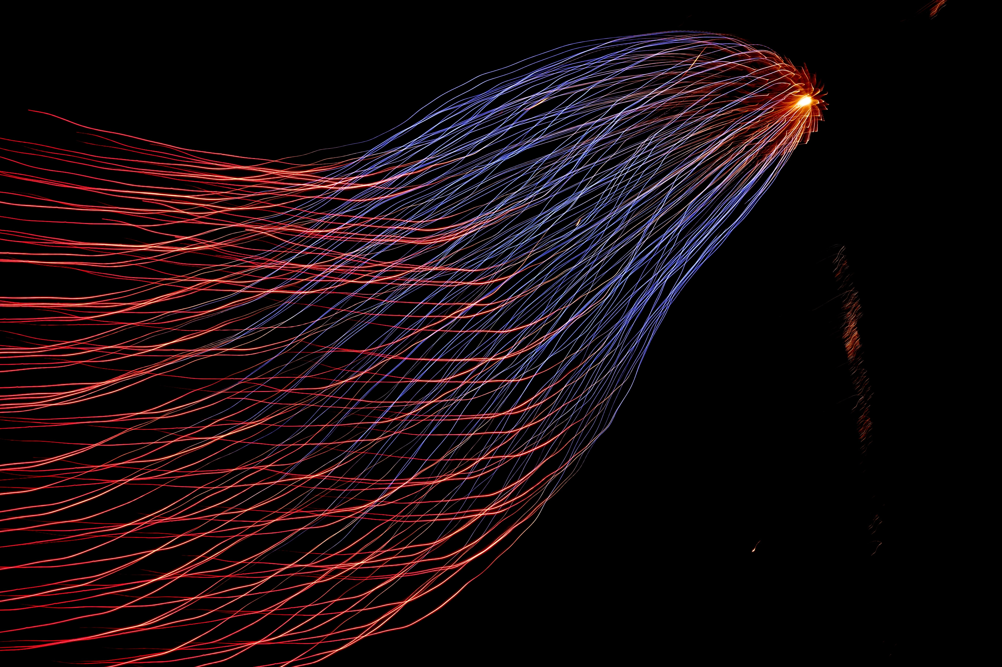
Goals
Create a dashboard that can
[1] stream tweets with filters so that we listen to relevant key words and phrases
[2] effectively classify tweets into negative, neutral, and
positive sentiments
[3] Flag the strongly negative tweets so they can be dealt with if necessary

Slide 5
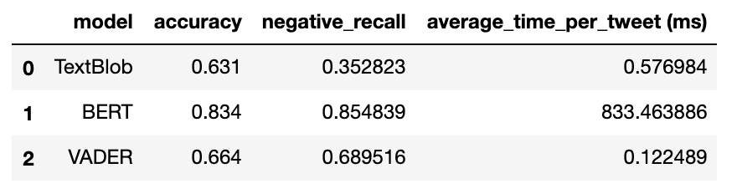
Models: TextBlob vs. BERT vs. VADER
Best Accuracy: BERT
Best Negative Recall: BERT
Best Compute Time: VADER
BERT
- Neural Network
- Powerful (highest accuracy and negative recall)
- Heavy and slow
VADER
- Lexicon based (sentiment-related words)
- Performs relatively well in social media
- low accuracy
Implementation: We will use VADER to initially classify sentiments, then use BERT model for extreme tweets ONLY.

Slide 6
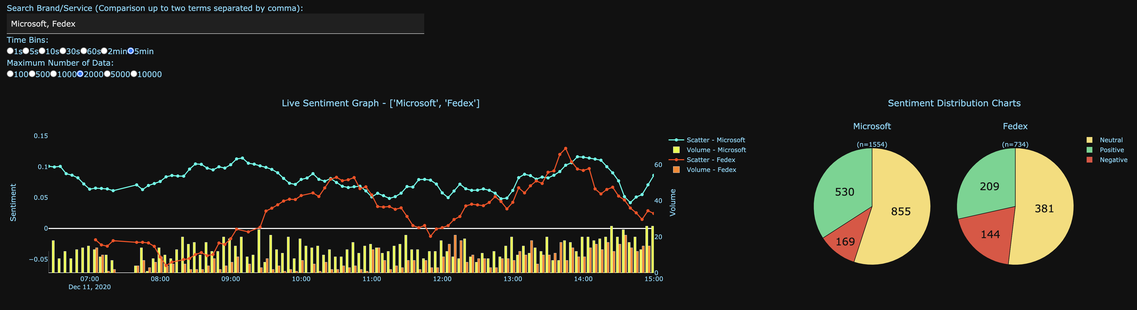
Dashboard
- Keywords to look for
(Up to two comparisons!)
- Change the number of data displayed in the graph
Sentiment distribution
Real-time moving average sentiment values.
Number of tweets per period of time.
Notes:
Rec3: Real time --> PR

Slide 7
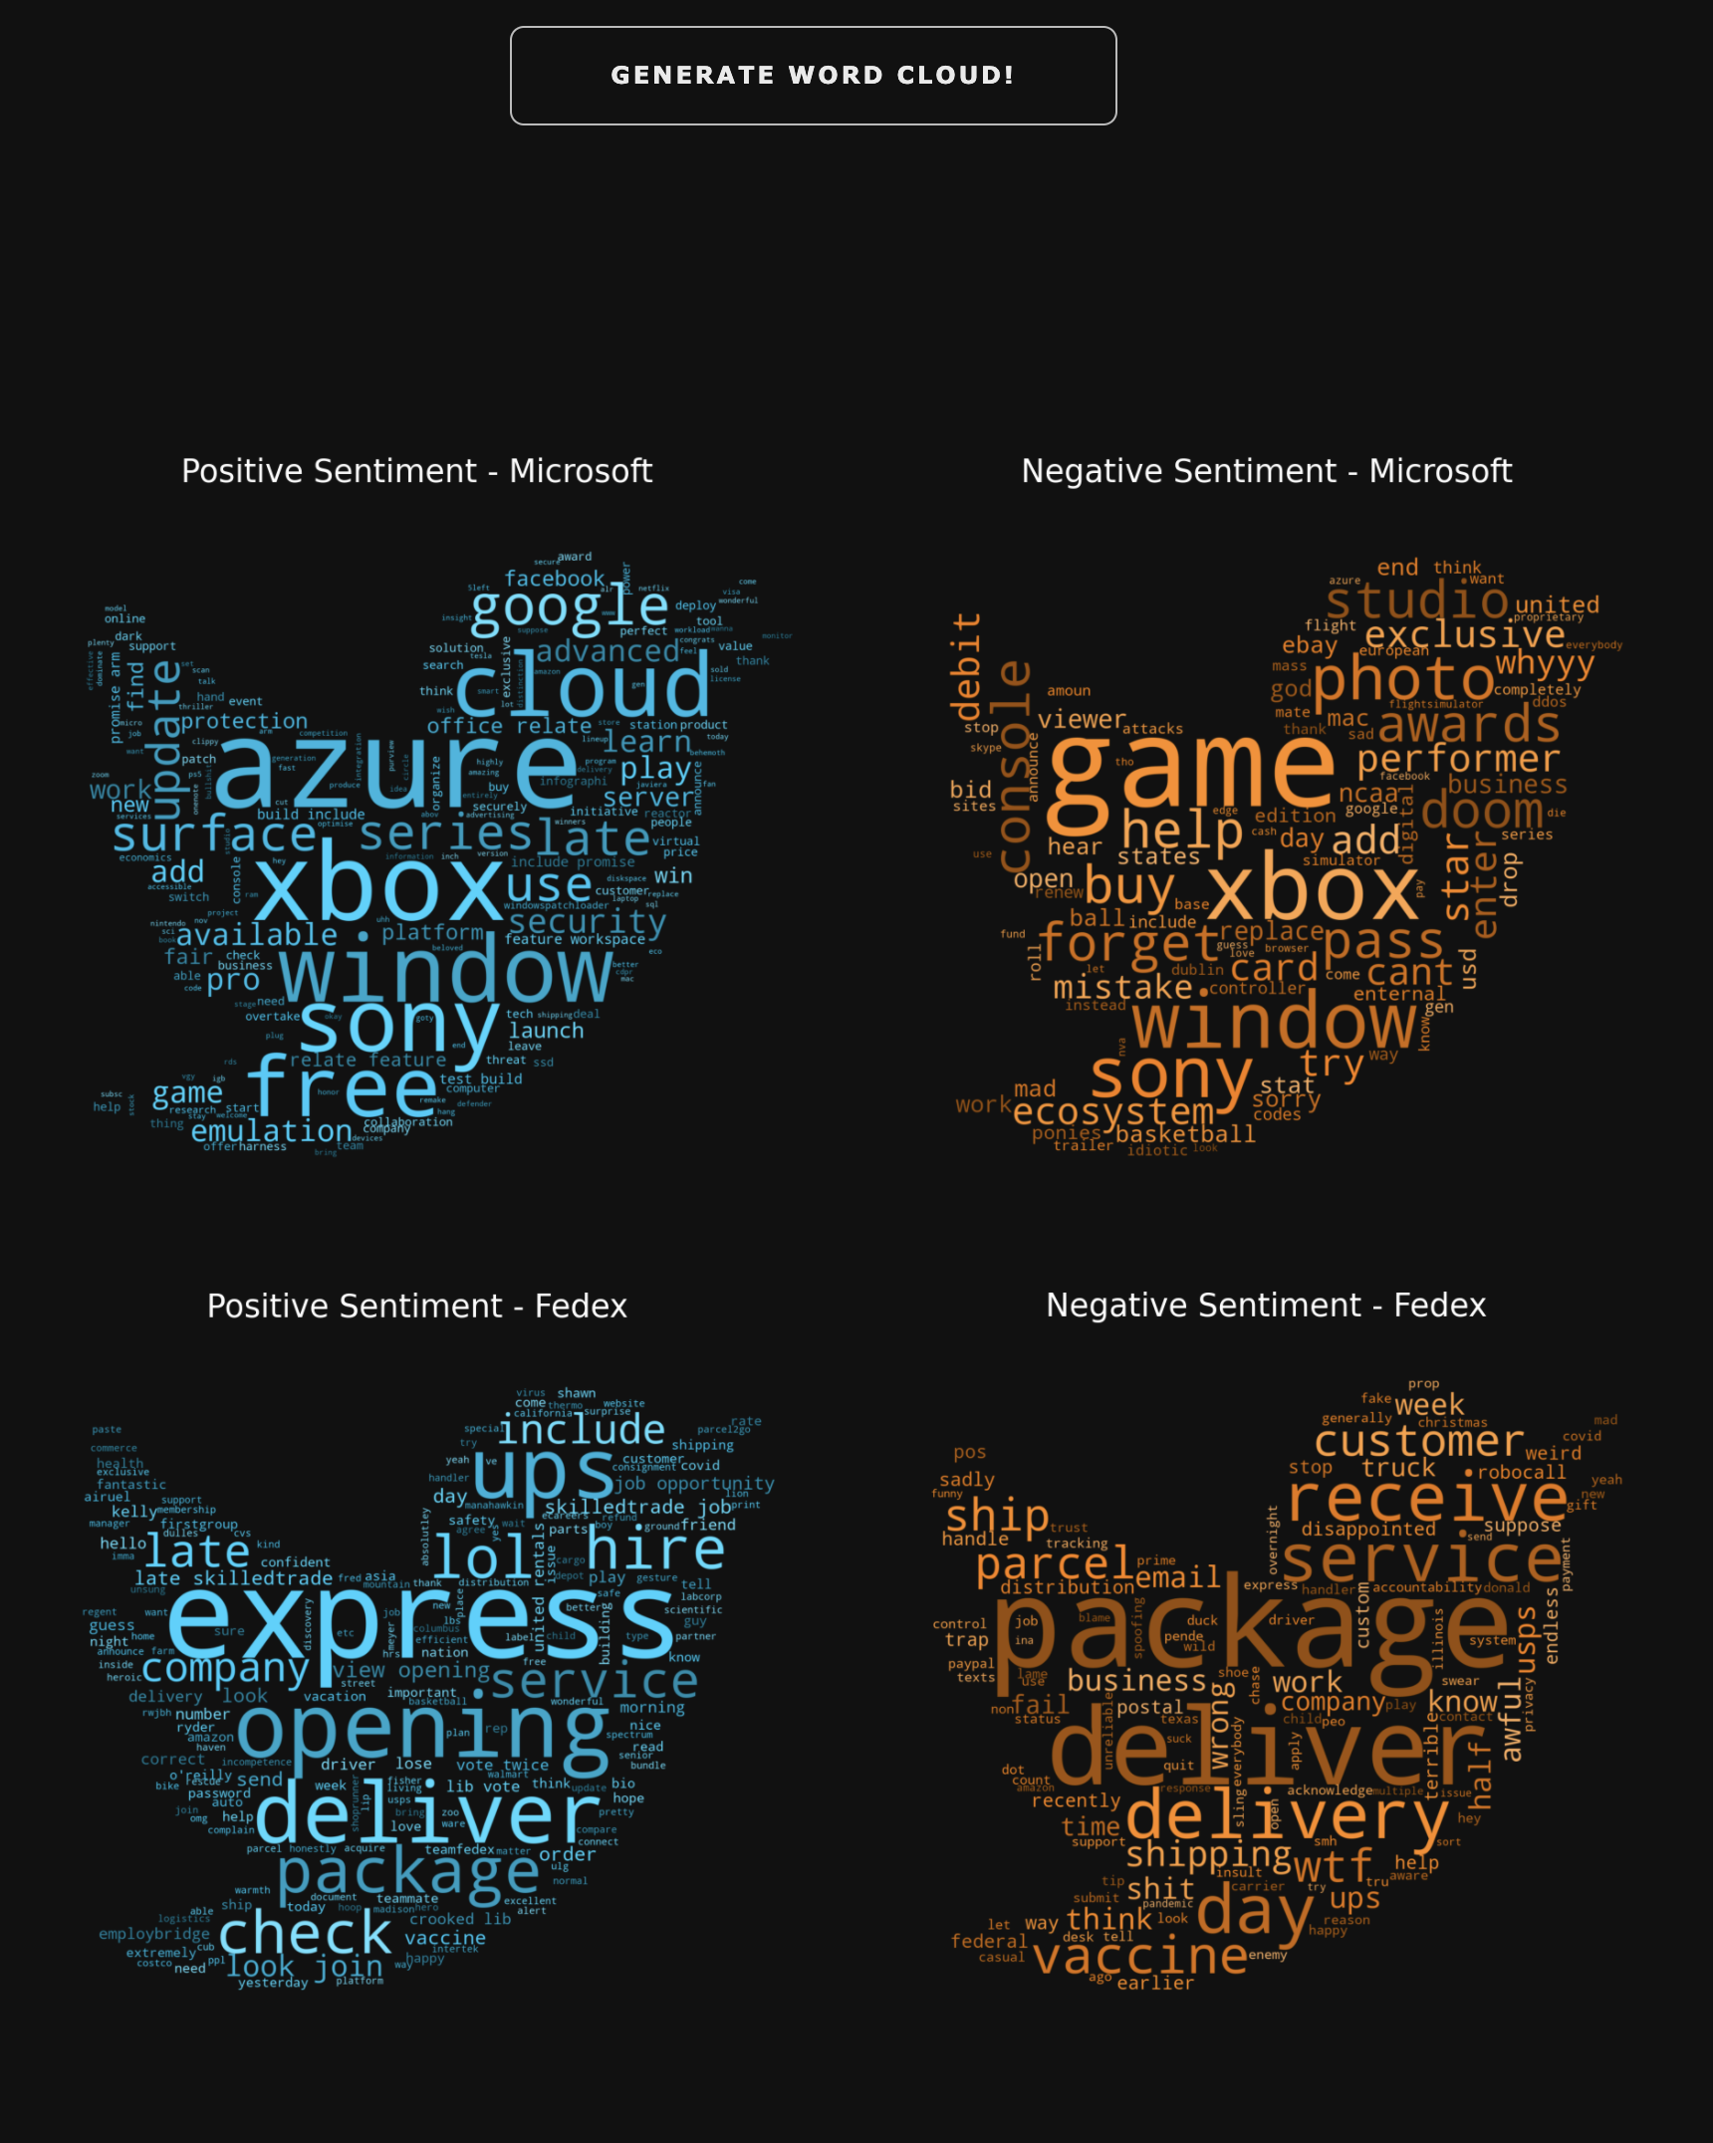
Dashboard
- Press this button to generate
word clouds associated with the keywords
- Visualize what words are used frequently with your service/product
- Visualize trends associate with your service/product or other competitors
- Further analysis can be done

Slide 8
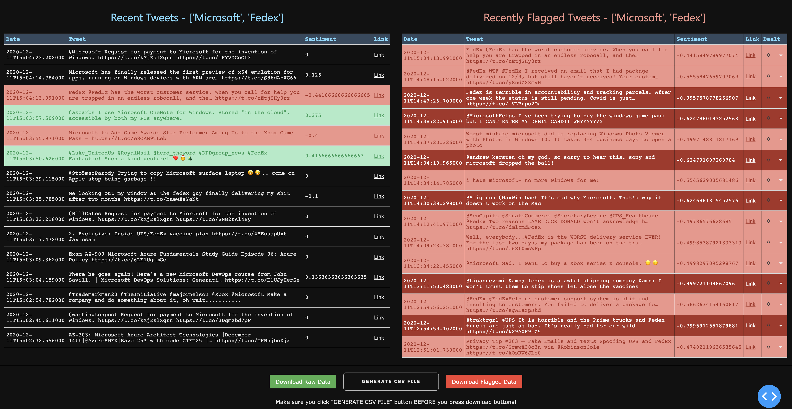
Dashboard
Live update of flagged tweets.
These flagged tweets are confirmed by BERT model which has 83% accuracy.
Live update of tweets.
Predicted by TextBlob Model which has low accuracy but high efficiency!
Make sure you press “GENERATE CSV FILE” to prepare “CSV” files for further analysis!

Slide 9
Use Recommendation 1
Monitoring Negative Trends/Features:
Being able to monitor negative feedbacks/tweets from people would give a great way to respond to the customers swiftly and directly.
By collecting more tweets about your products/services, you will be able to see which features need improvements

Slide 10
Use Recommendation 2
Monitoring Positive Trends/Features:
Monitoring positive trends is as important as monitoring negative trends since it would give a chance to thank them and build upon positive features for improvements.
Notes:
rec1 : monitor negative sentiments - intervene
rec2 ; get positrive so discover positive features
rec3: model/maintenance (?) -

Slide 11
Use Recommendation 3
Real-Time Response – Public Relations (PR)
- The biggest strength of this dashboard is that it is a real-time monitor. So, monitoring the trends of the people would give deeper insight on how to strategize PR .

Slide 12
Future Direction
1. Database structure
- As the database size increases, it might get too much for sqlite3 to handle. So, we want to separate database into parts so only when a large number of data is requested, we can combine or join smaller databases.
2. Reply feature
- It would be nice if we could add a feature where you could reply to any of tweets shown in the dashboard without going to twitter page.
3. Multiple keywords
- It would be nice if multiple keywords can be analyzed and followed at a given time.
4. Table Editing Mode
- Modify flagged tweets in the dashboard so that a user can classify flagged tweets as 'resolved', 'false negative', or 'other' for further customer service / data analysis.
5. Further analysis on both positive and negative tweets
- Find any correlation between tweet trends with how the company is doing to help with future direction of a company.

Slide 13
Thank you for listening

Slide 14
Appendix

Slide 15
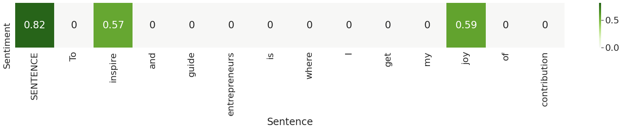
TextBlob and VADER: How they work?
Lexicon based: Each sentiment-related words have values assigned to them, and the sum of these values determine the overall sentiment
*The main difference between VADER and TextBlob is that VADER handles punctuations and emojis differently.

Slide 16
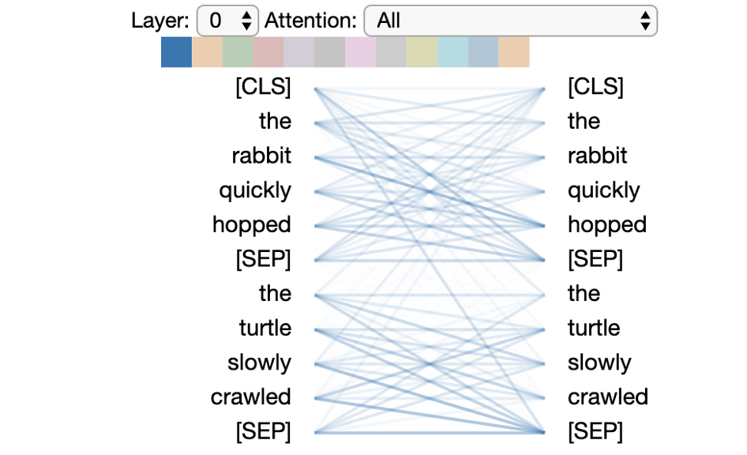
BERT: How it works?
The model learns how each word is used relatively to other words used in a text. So it is able to understand the context as well. It is a very popular and powerful model.
Notes:
https://towardsdatascience.com/deconstructing-bert-part-2-visualizing-the-inner-workings-of-attention-60a16d86b5c1

